Slide 1

Wireframes
Mohammad Shahidh Mohammad Khaidir

Slide 2
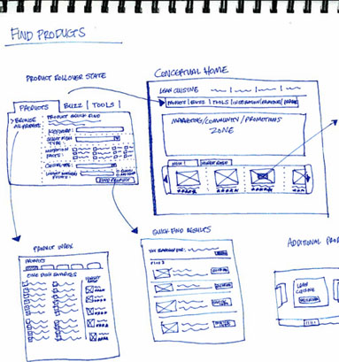
Missing Pages
?

Slide 3
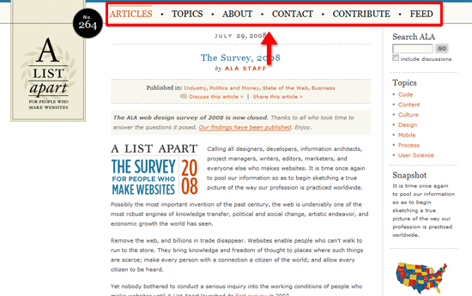
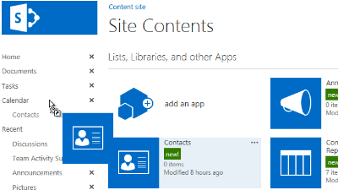
Navigation

Slide 4





Navigation
LOGO = Home Button

Slide 5

Task for Today

